Slide 1
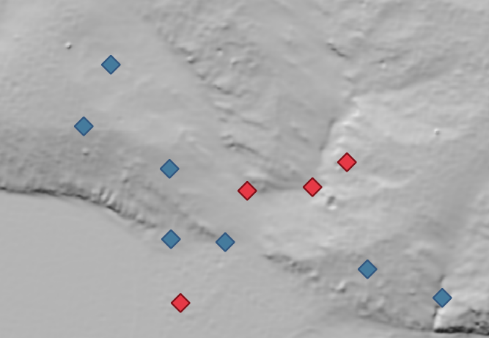
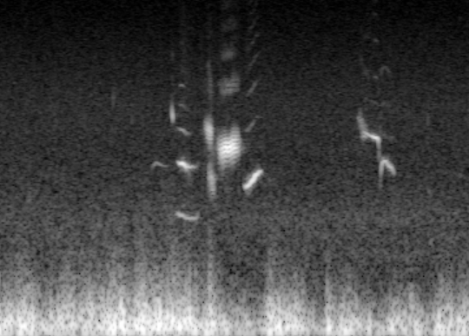
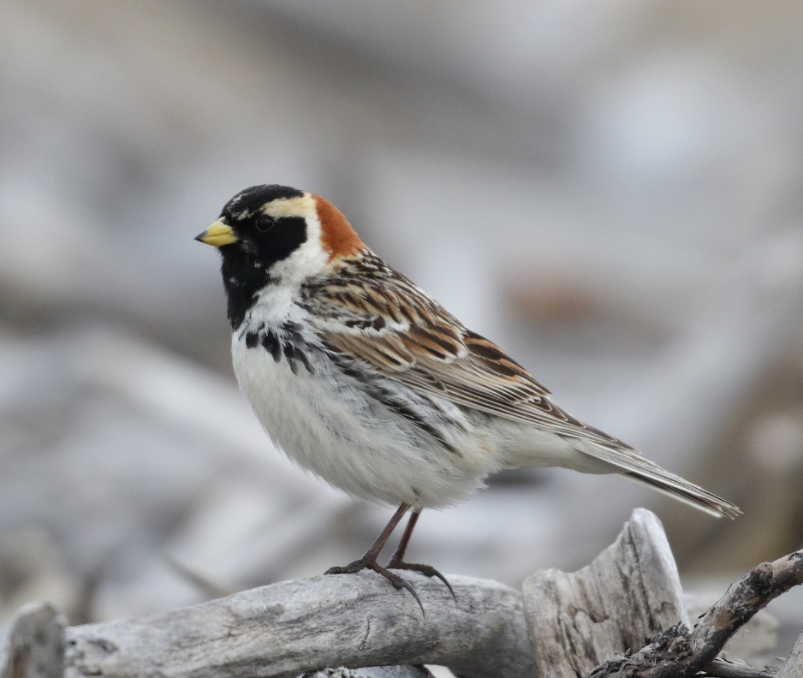
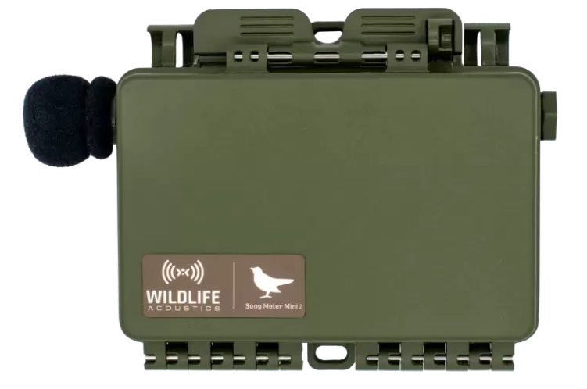
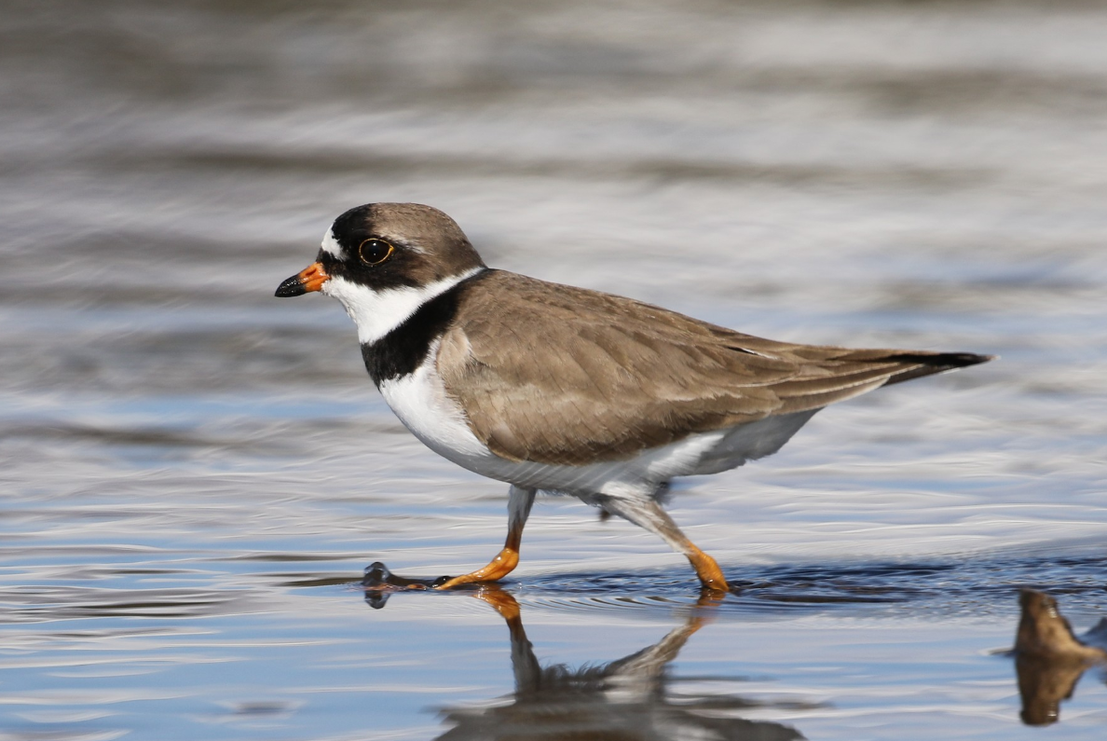
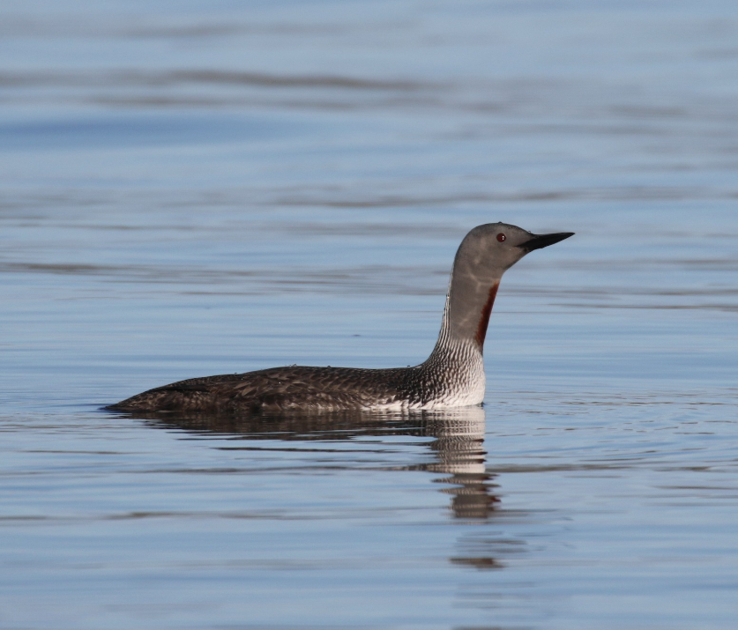
Figure X1: Conceptual Diagram
A)
Breeding Temperature
Sea Ice Drop Date
Breeding Temperature
Snowmelt
Budburst
BirdNET AI Birdsong Recognizer
Abundance
Passerine
Shorebird
Waterbird
B)
Warm Site
Cold Site
Theoretical Vocalization Frequency

Slide 2
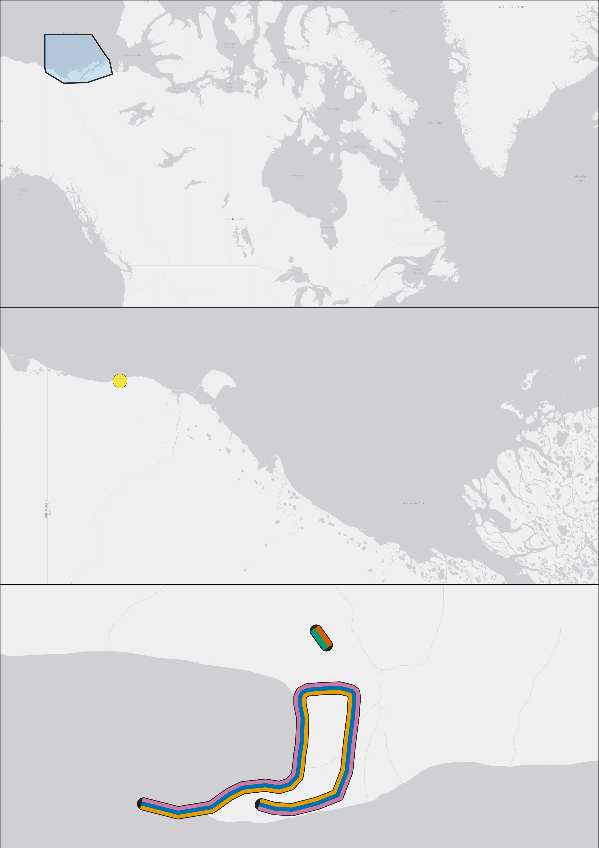
Canada
Figure X2: Breeding Bird Survey and Variables Site Map
Map of North Slope
Breeding Bird Survey Drawn Out
Icemelt drop region polygon
Location of snowmelt and plant phenology transects
Komakuk breeding temperature site
Beaufort Sea, Mackenzie Delta
Sea Ice Drop Date
Yukon North Slope
Komakuk Beach
Breeding Temperature
Pauline Cove, Qikiqtaruk
Phenology Transects
Breeding Bird Survey
Budburst
Passerine Abundance
Snowmelt
Shorebird Abundance
Waterbird Abundance
End
Start

Slide 3
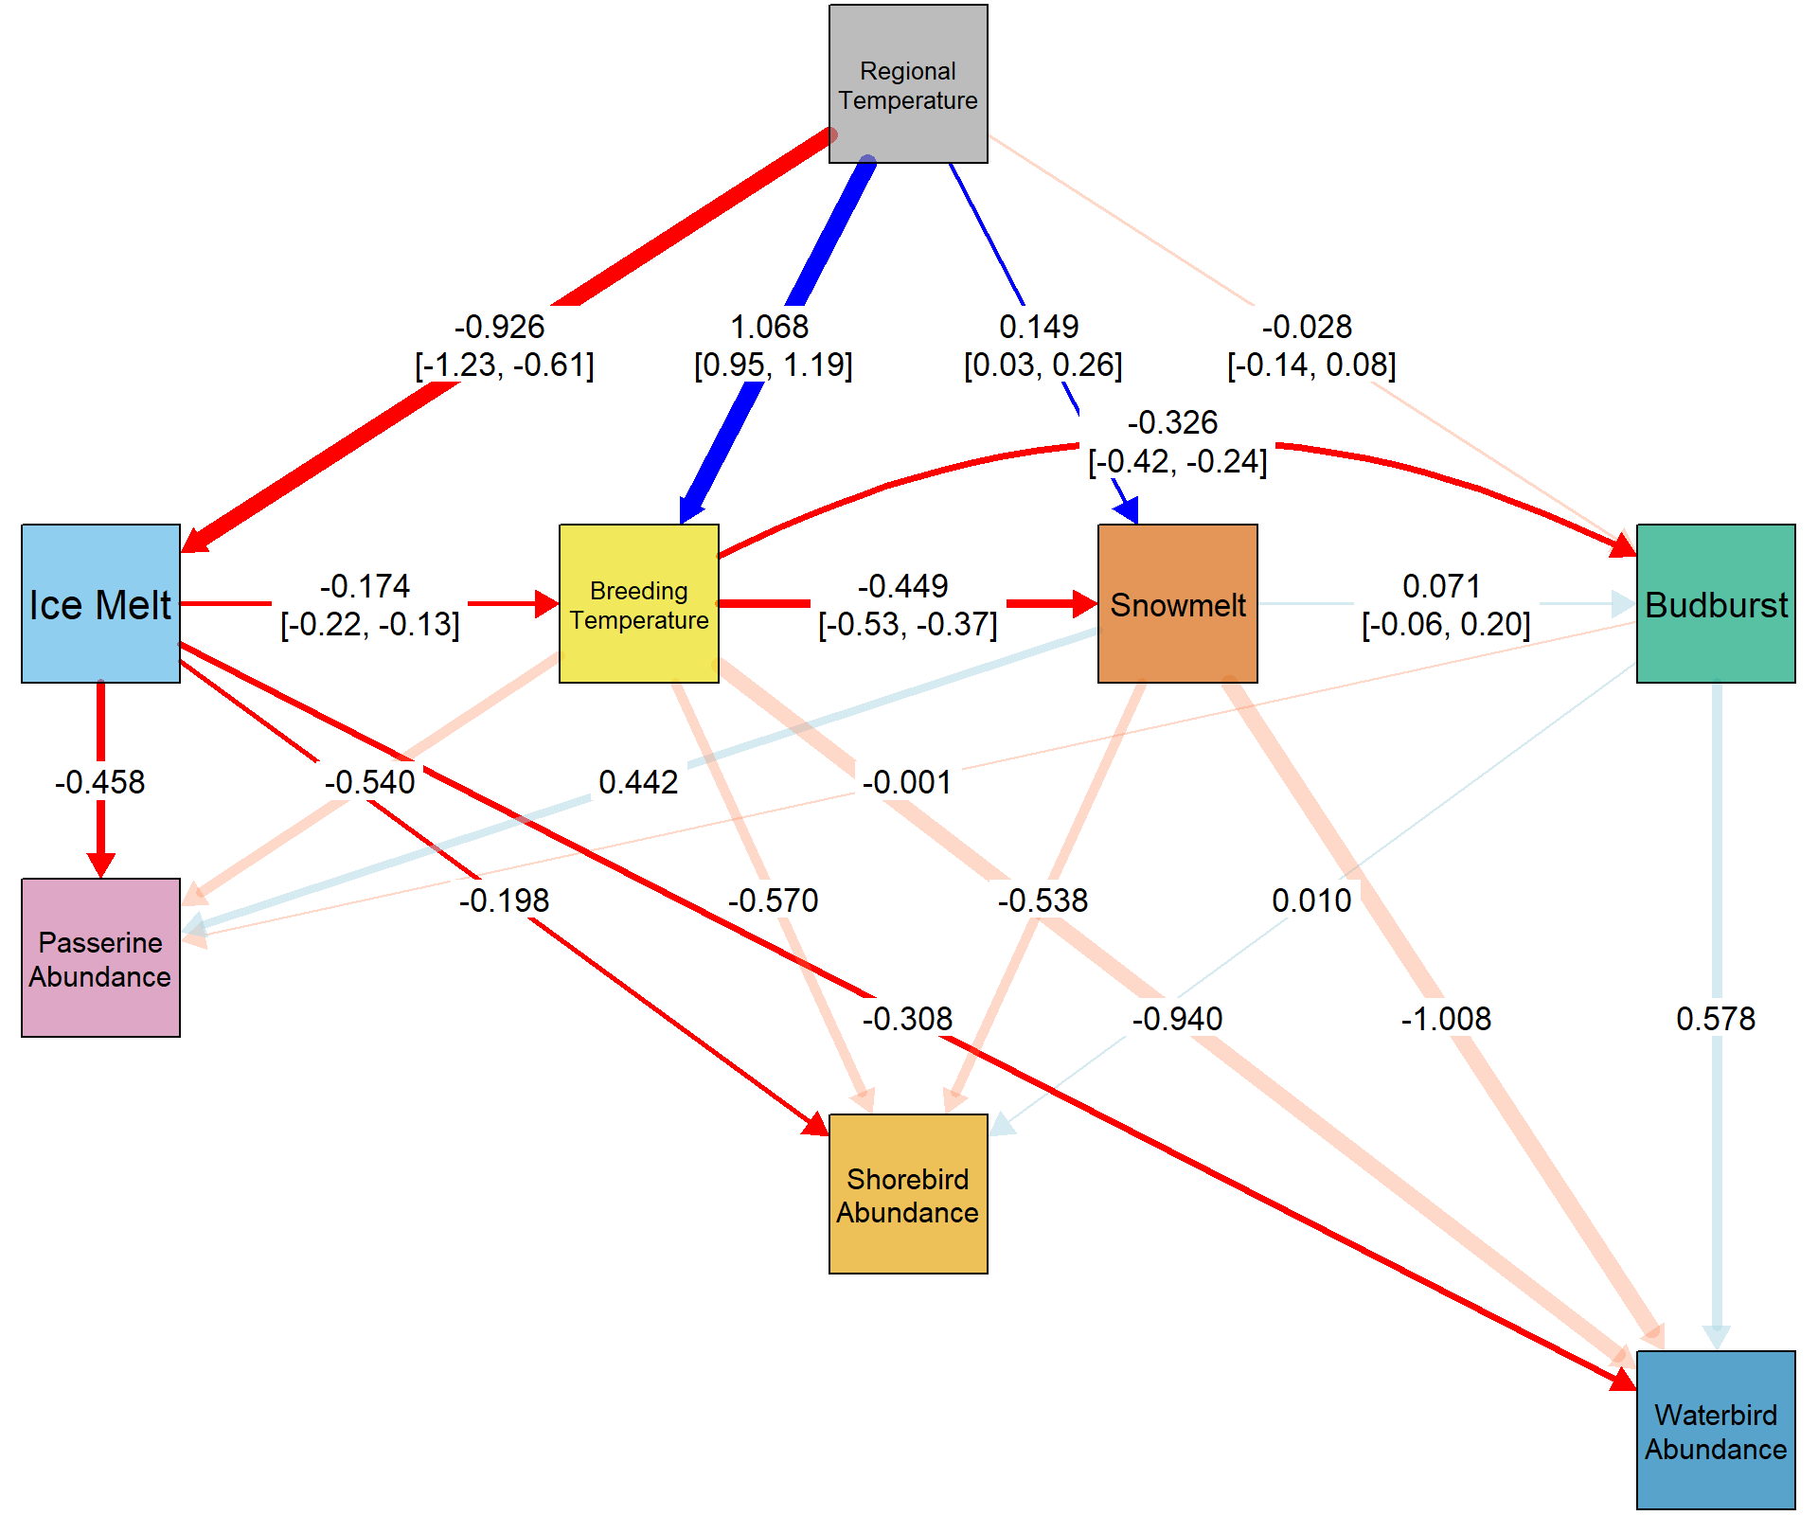
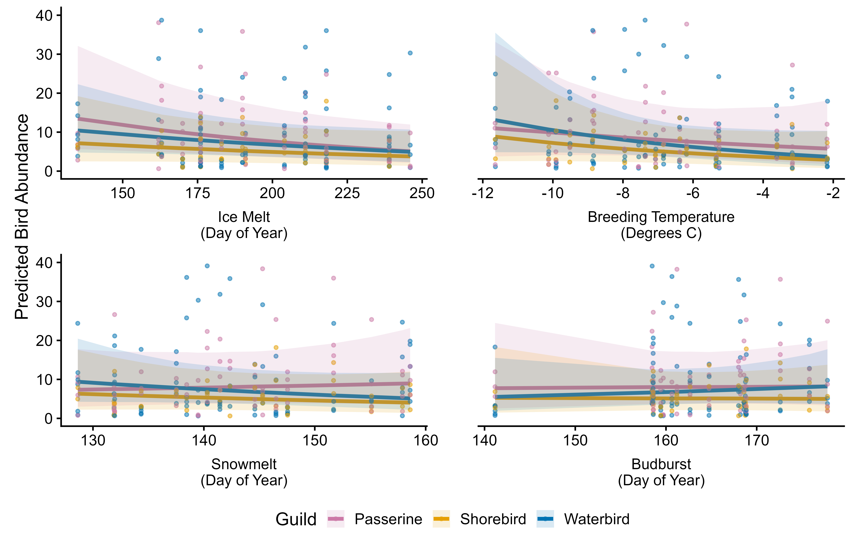
Figure X4: SEM
SEM plot
Predictions for each graph

Slide 4
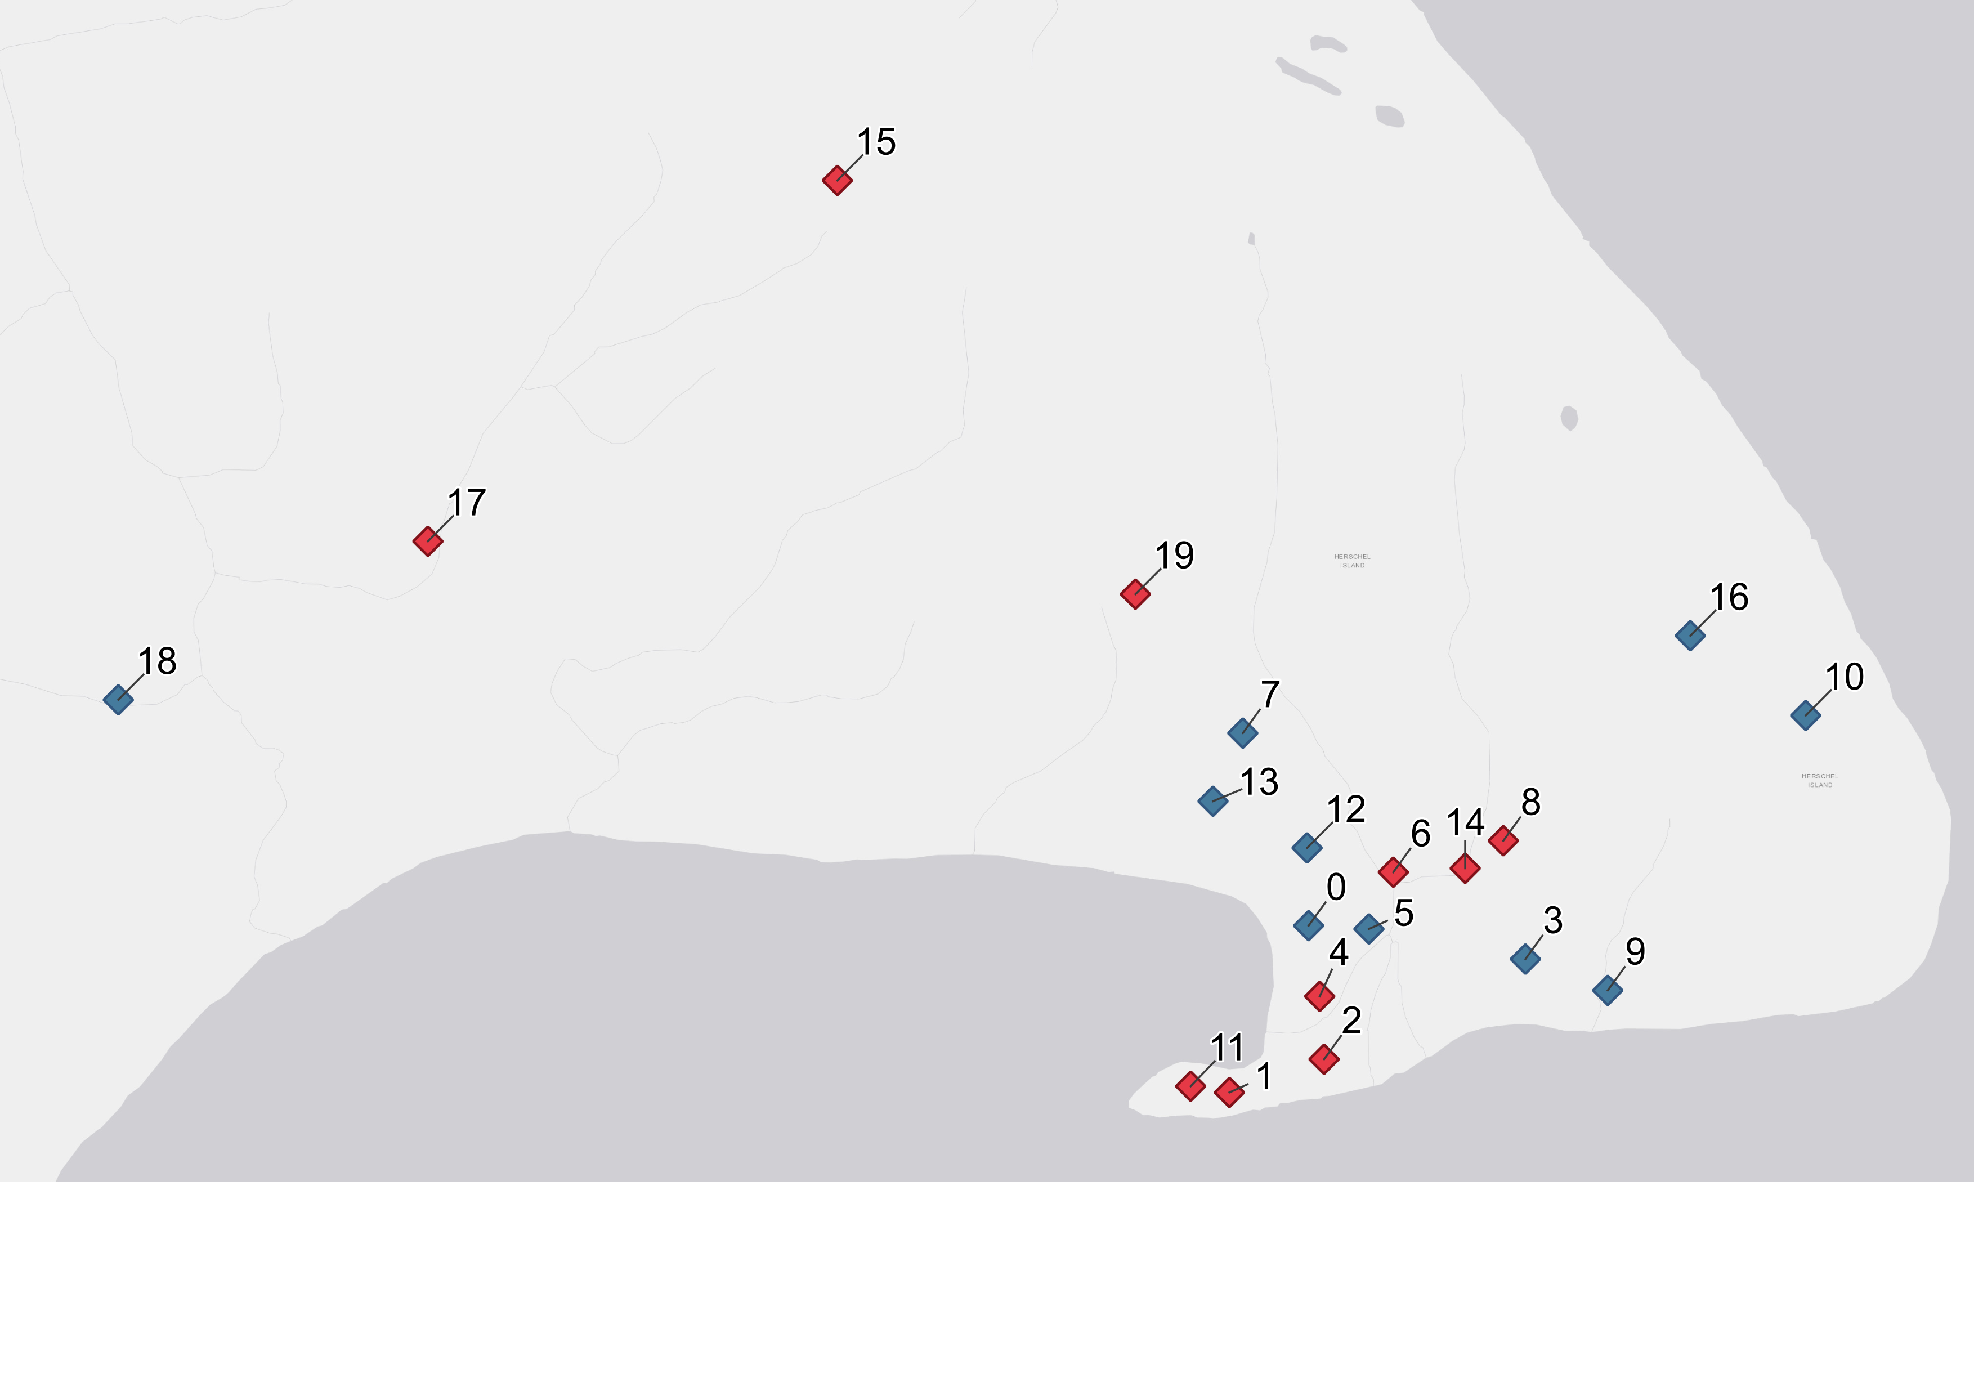
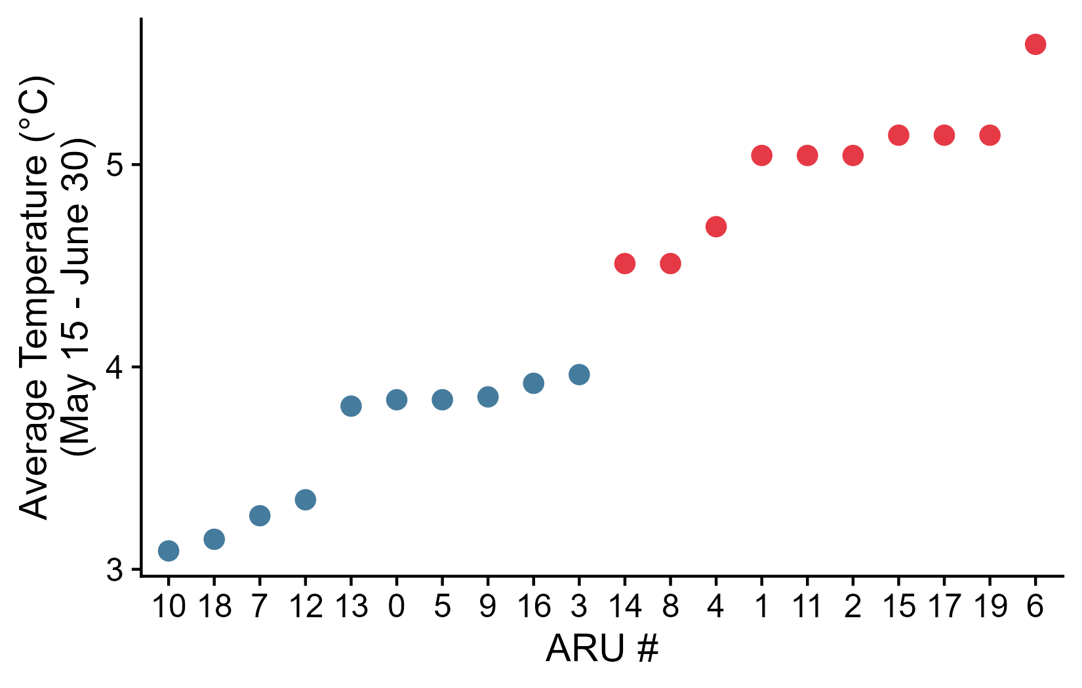
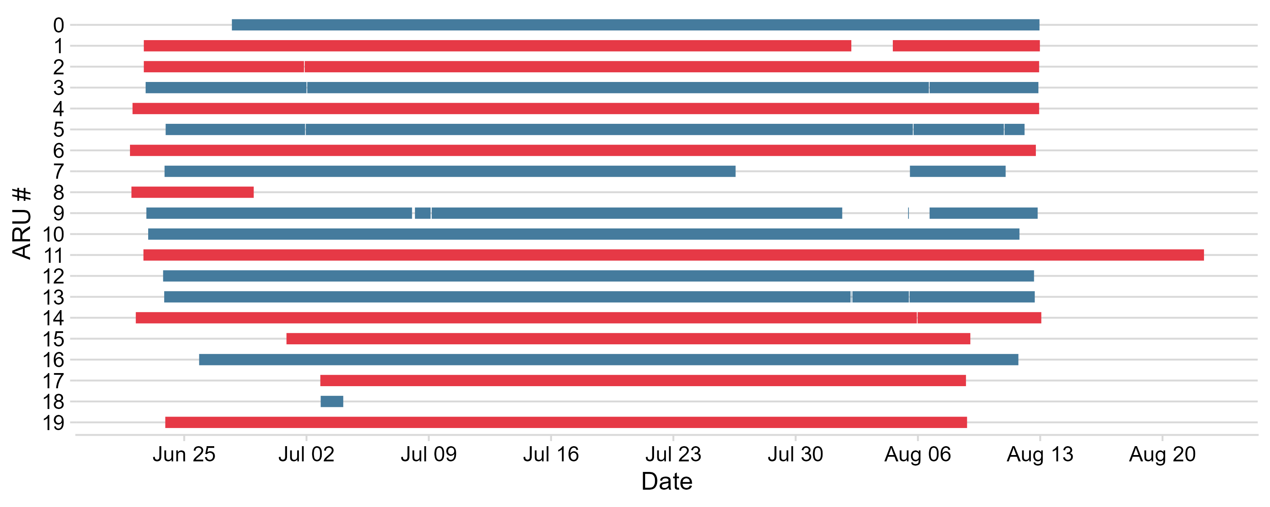
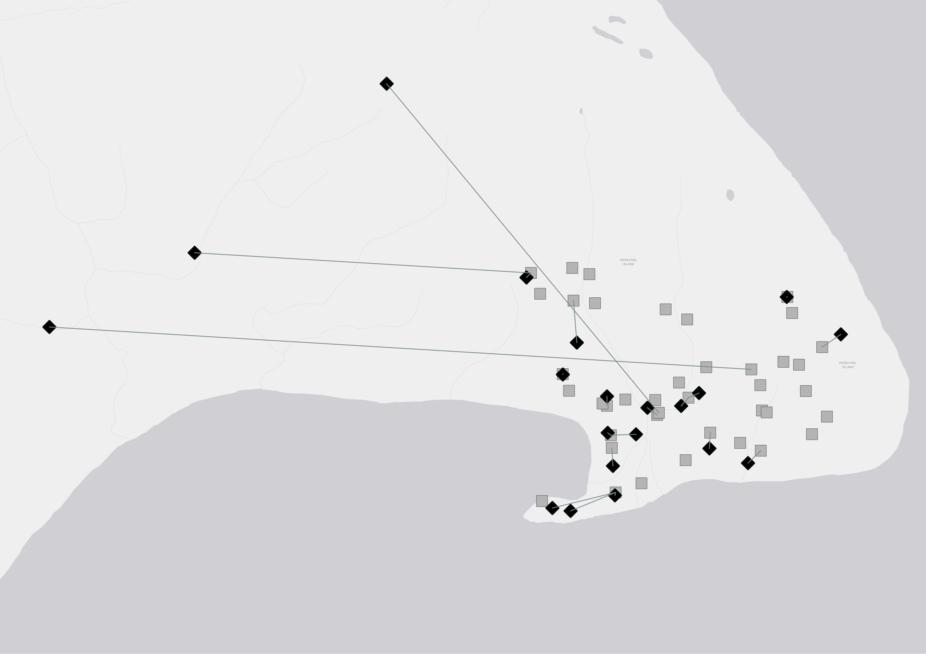
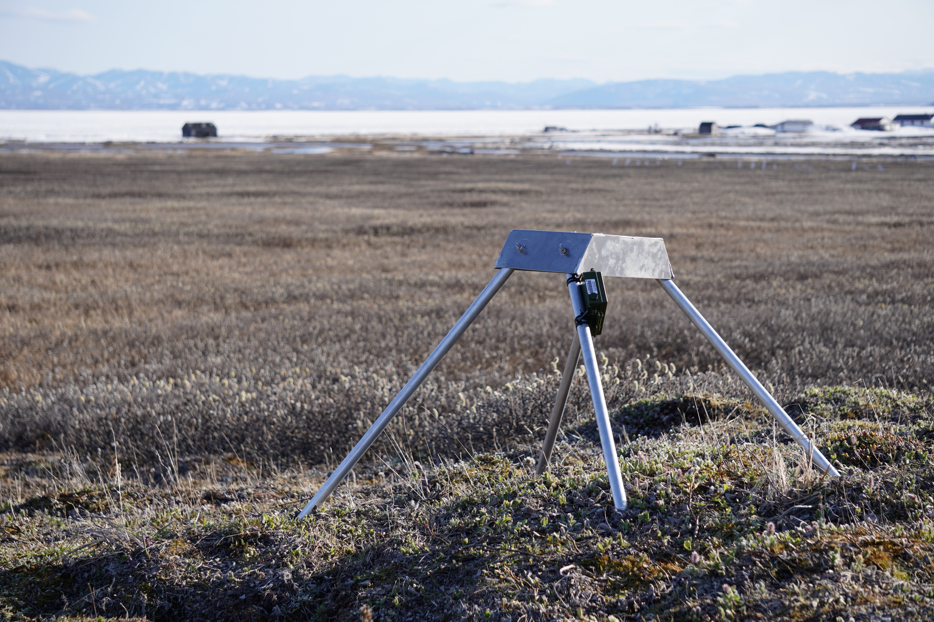
Figure X3: ARU site map
Localization in the world
Map of ARU sites (dots and maybe rings of estimated catchment)
TOMST drawn with dashed lines connecting to ARUs?
Picture of ARU setups
Figure of ARU coverage (ie when recording)
Deployment Map Breeding Season Temperature
May 15th – June 30th
> 4.25 °C < 4.25 °C
<4.25 °C
Autonomous Recording Units Active Periods
Chart Showing Activity Across Summer
Chart Showing Temperature Split
Deployment Example
Autonomous Recording Unit

Slide 5
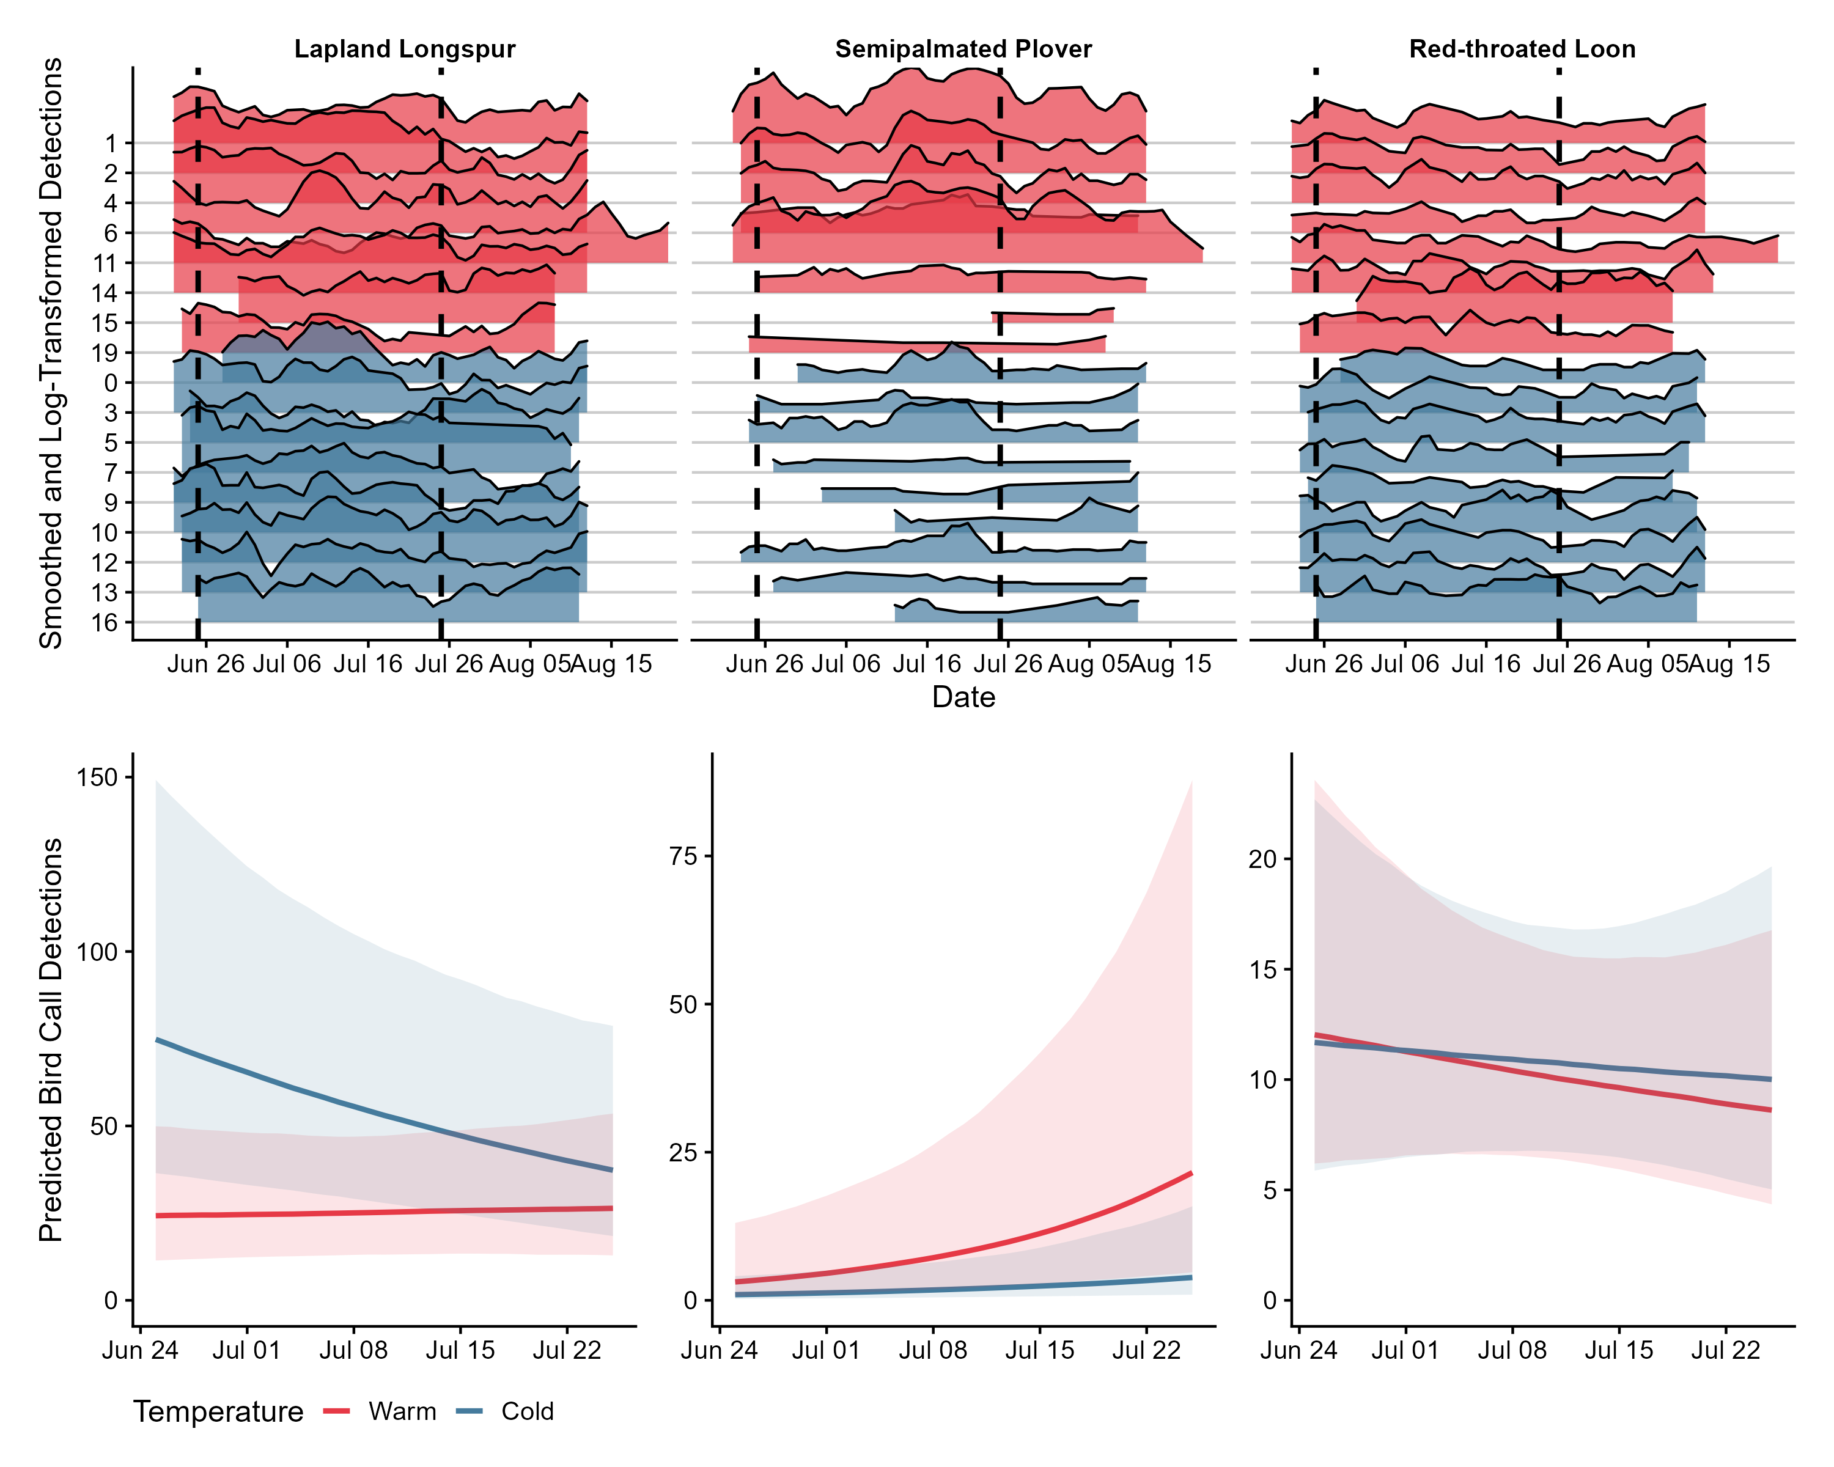
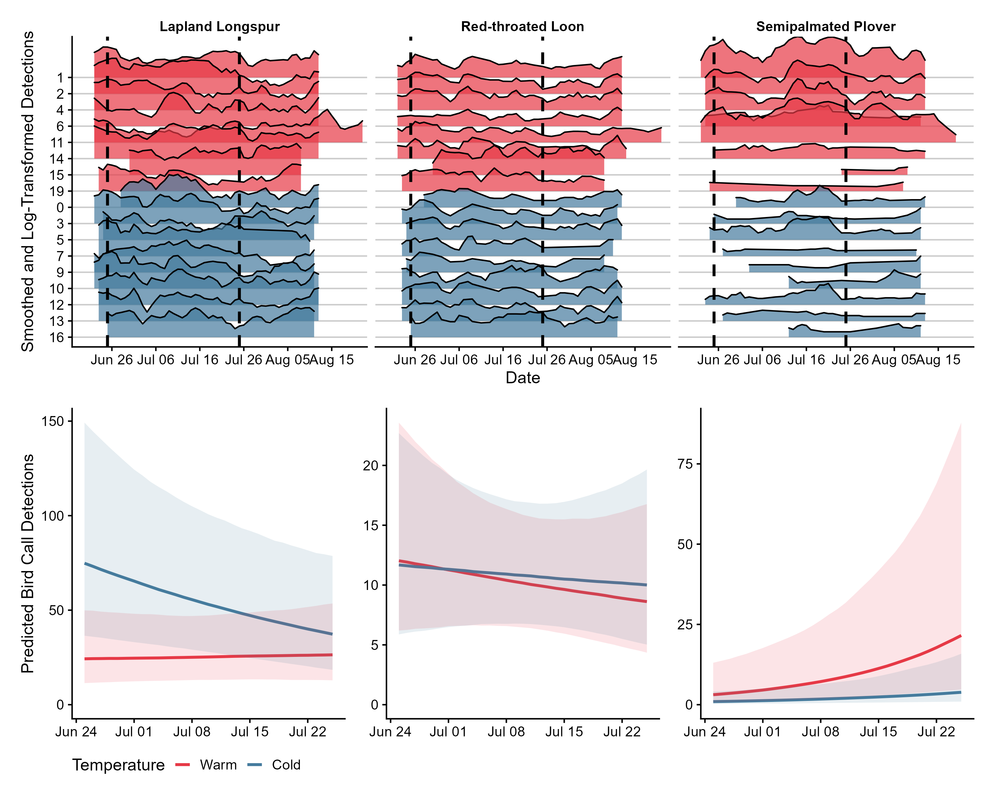
Figure X5: ARU vocalizations
Calling temp split plot
Regression
Colour coded picture of each bird
A)
B)
ARU #
C)

Slide 6
A)
Lapland Longspur
Theoretical Vocalization Frequency
Summer Breeding Season
B)
Semipalmated Plover
Theoretical Vocalization Frequency
Summer Breeding Season

Slide 7
Figure X6: Variables
Regression plots for each of the variables over time

Slide 8
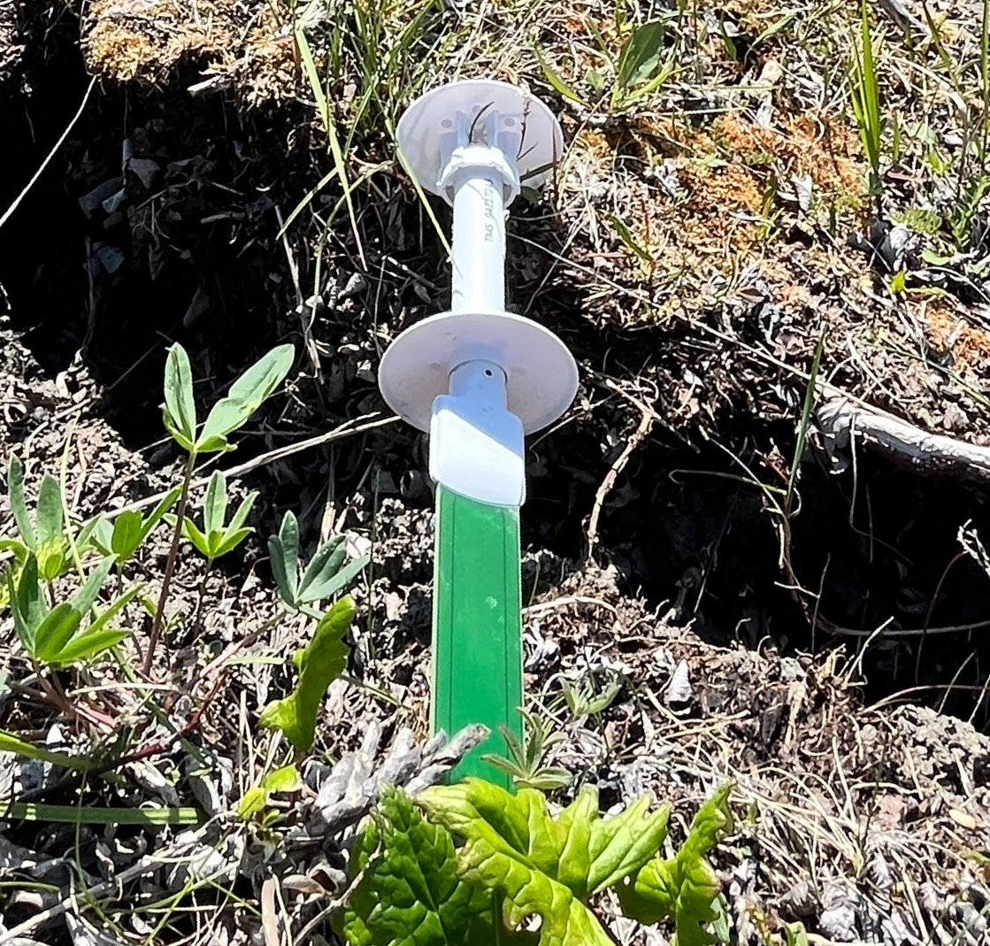

Slide 9
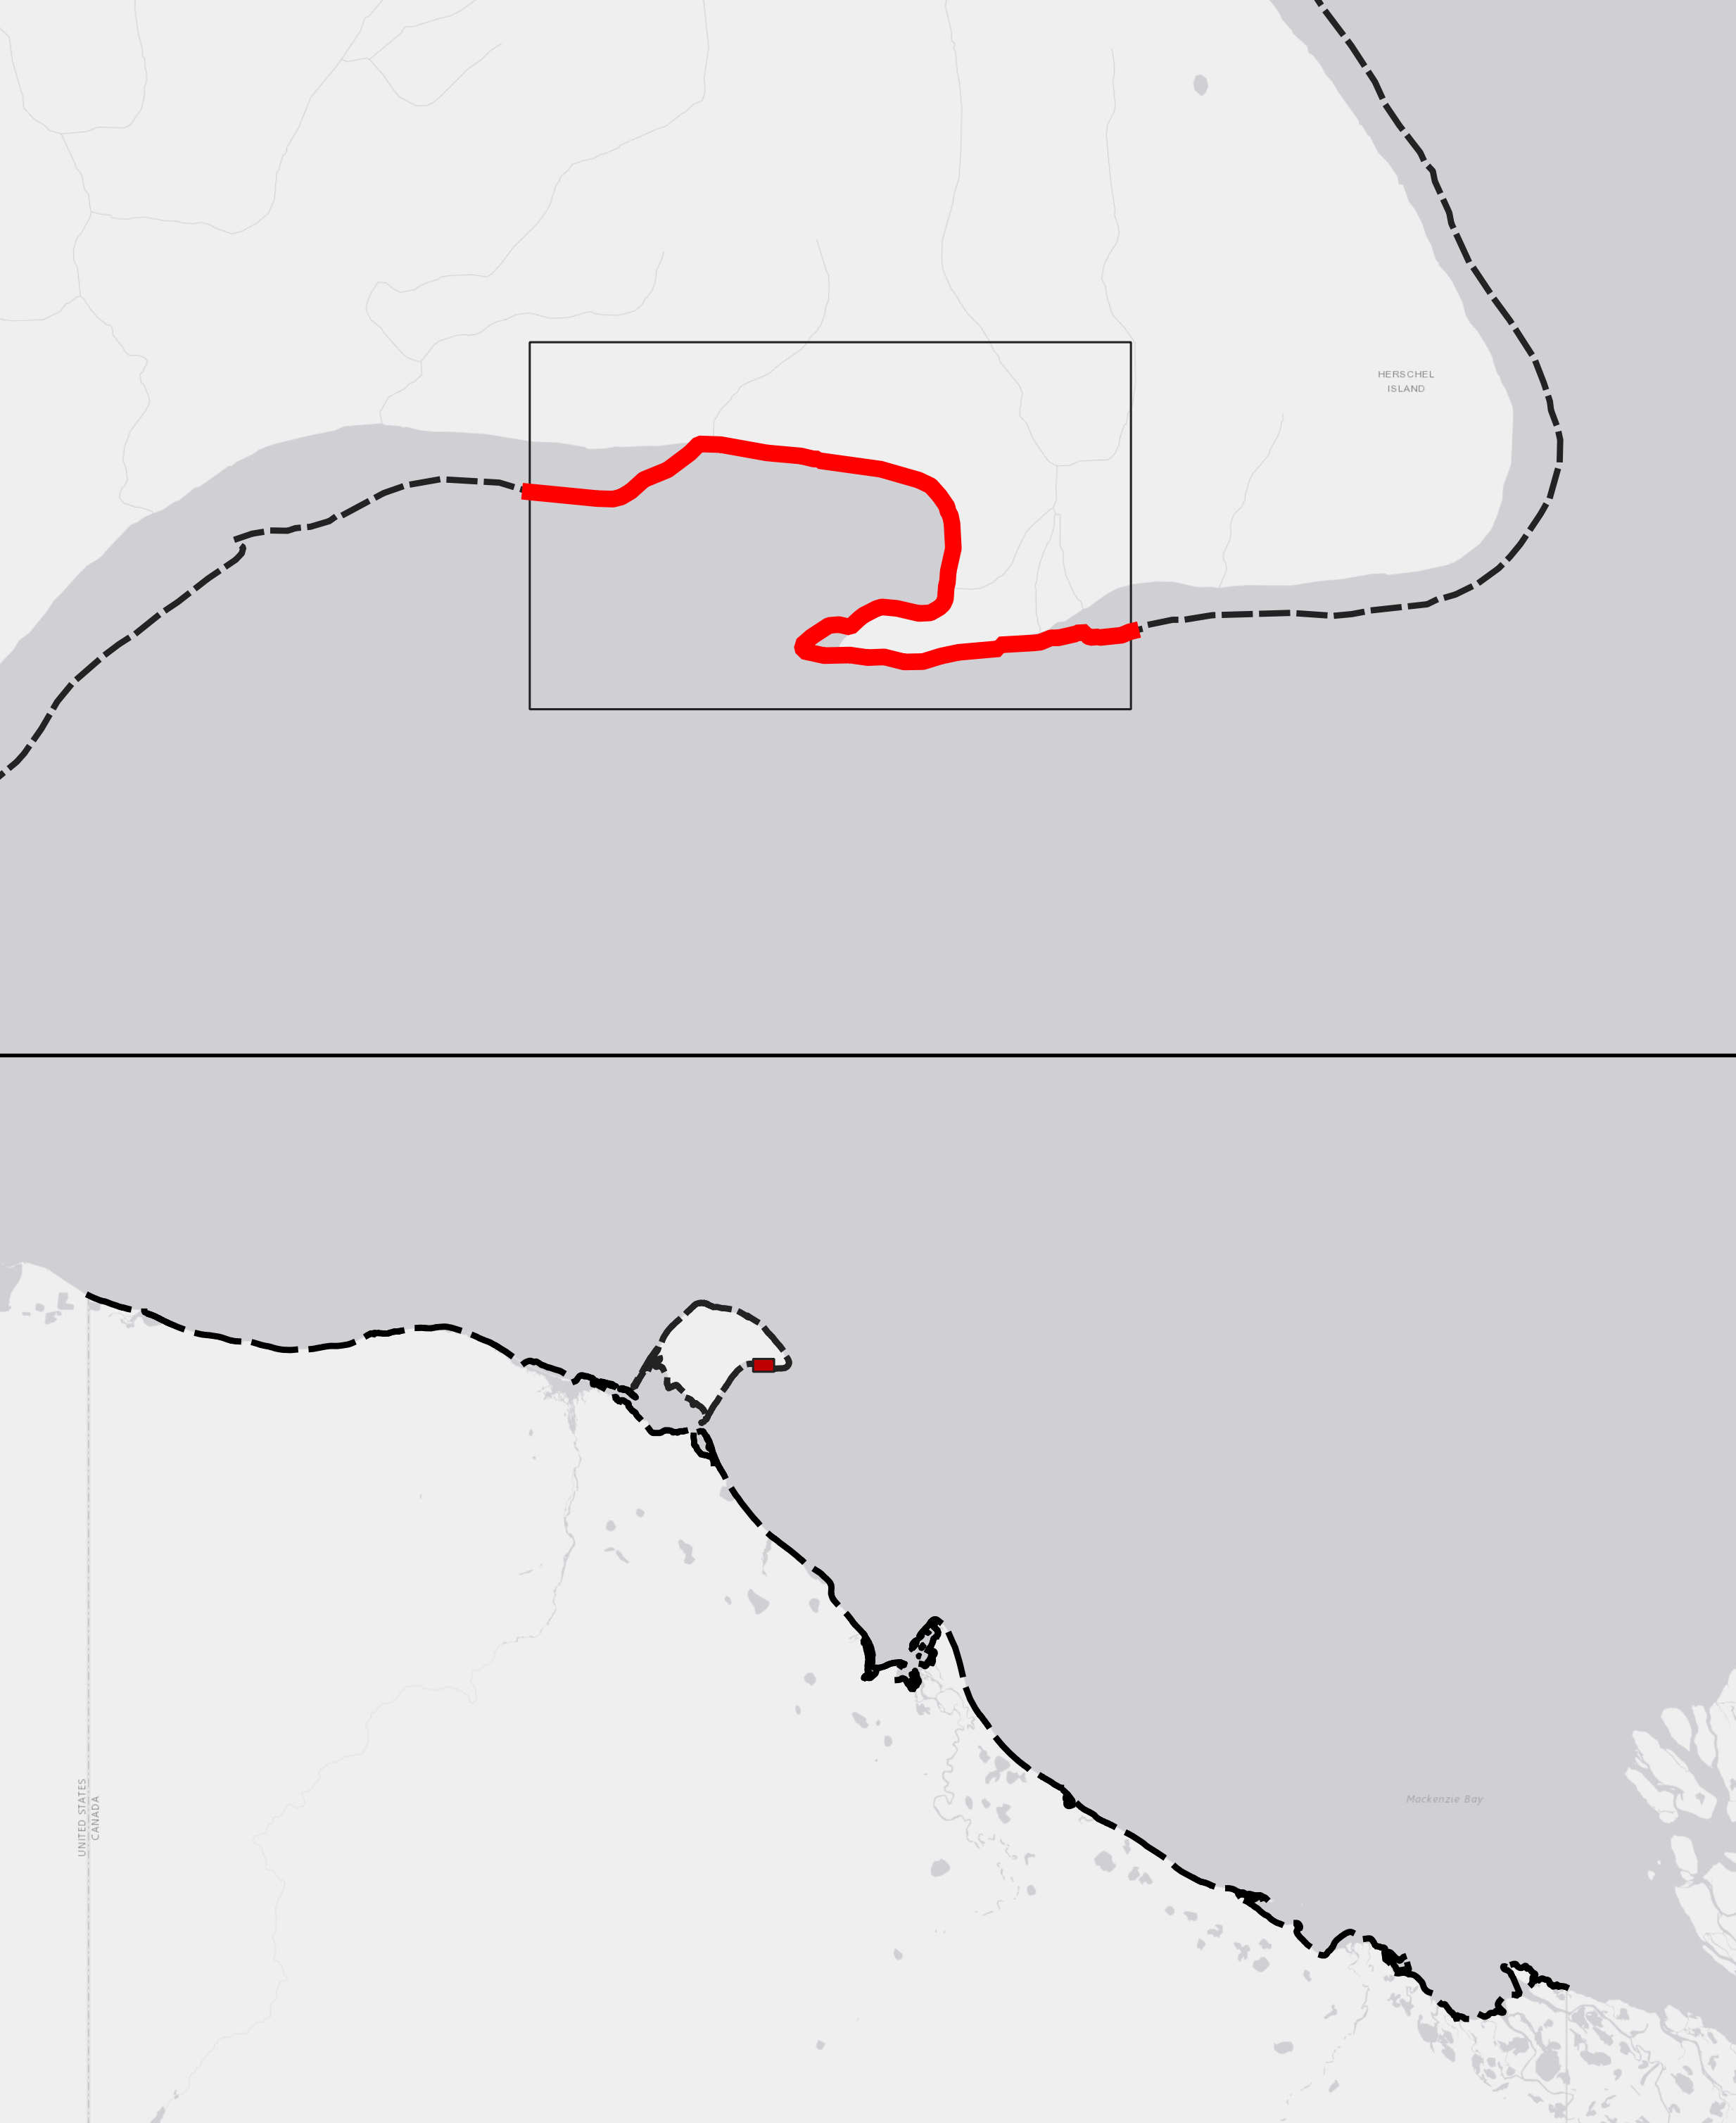
Figure X7: Coastline Lengths
Coastline near Breeding Bird Survey
~4400 metres
Coastline of Yukon North Slope
~430000 metres
97x longer than survey area

Slide 10
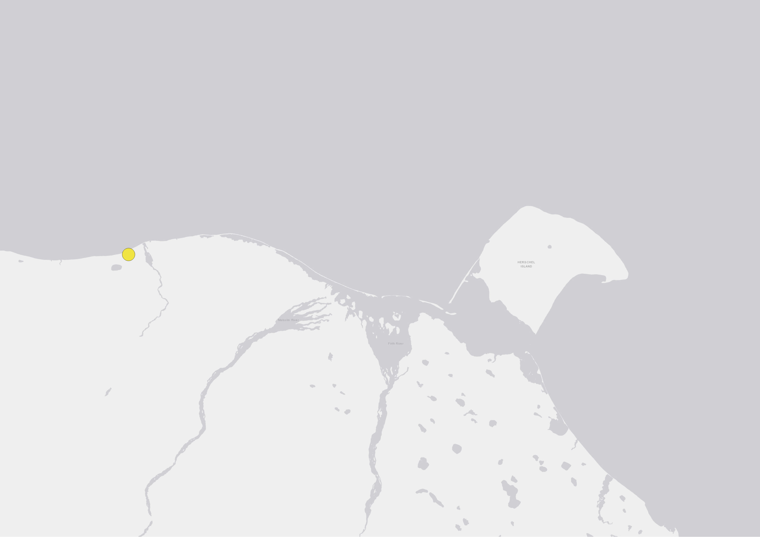
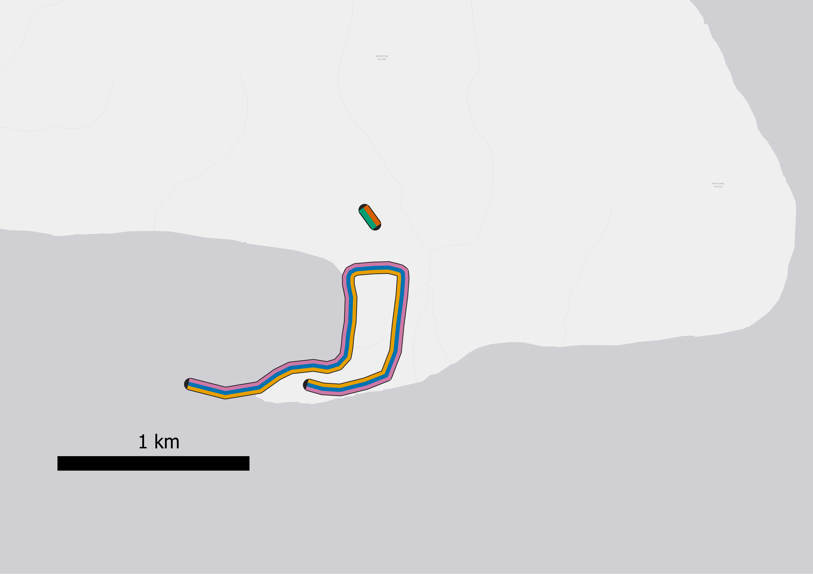
Figure X2: Breeding Bird Survey and Variables Site Map
Map of North Slope (coastline length annotated)
Breeding Bird Survey Drawn Out (coastline length annotated)
Icemelt drop region polygon
Location of snowmelt and plant phenology transects
Komakuk breeding temperature site

Slide 11
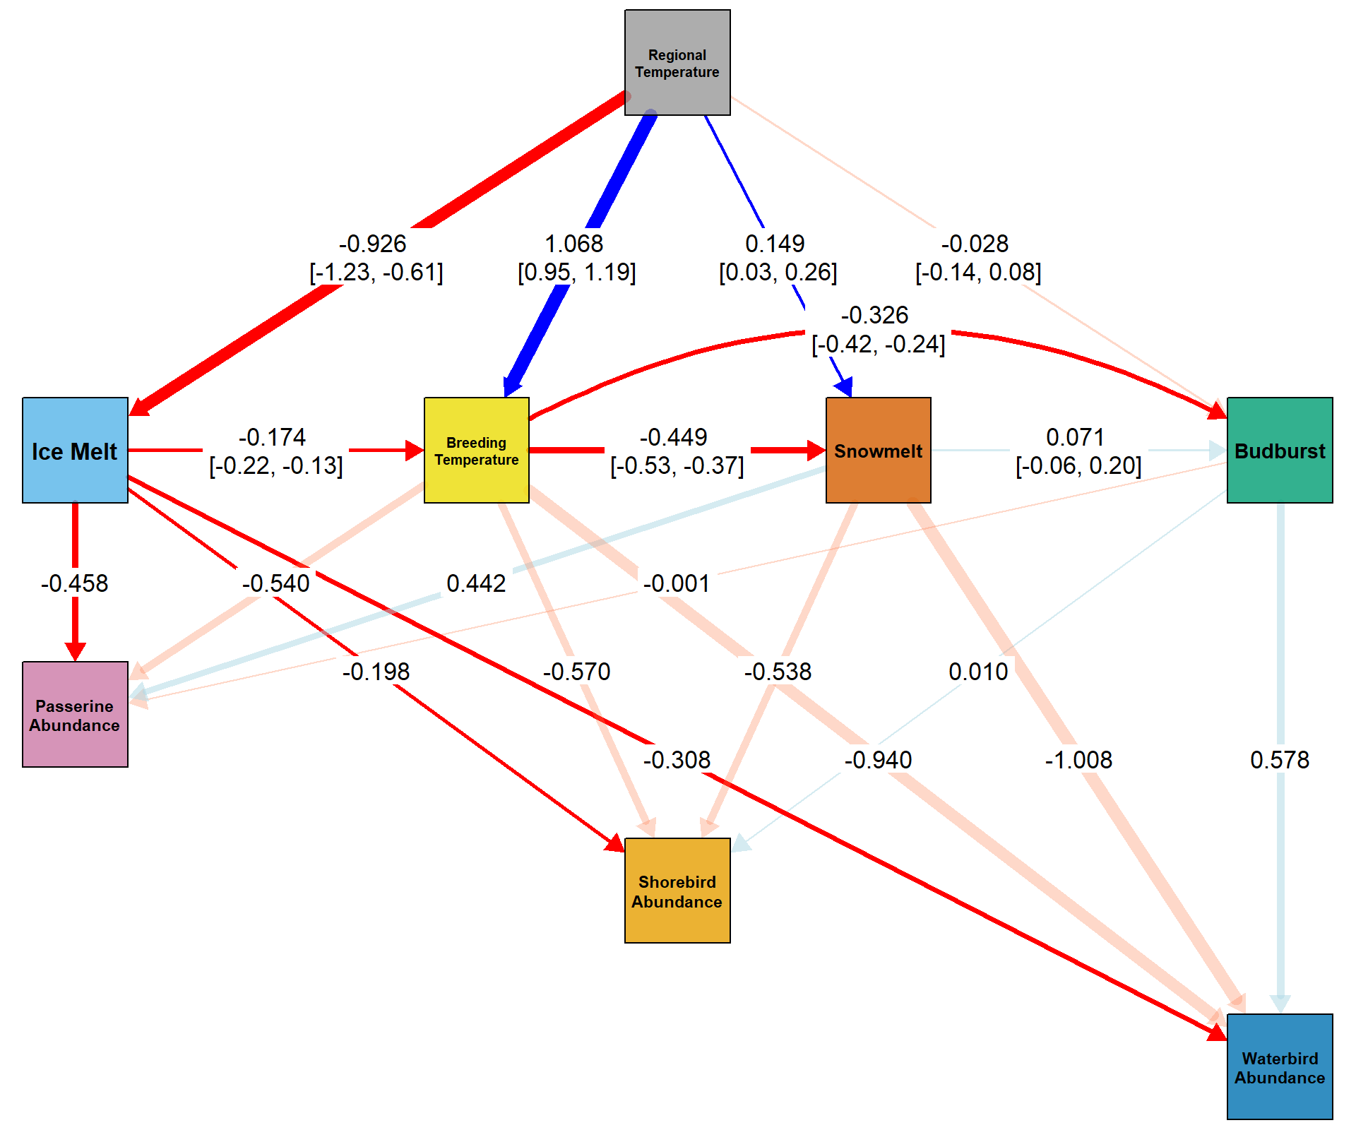
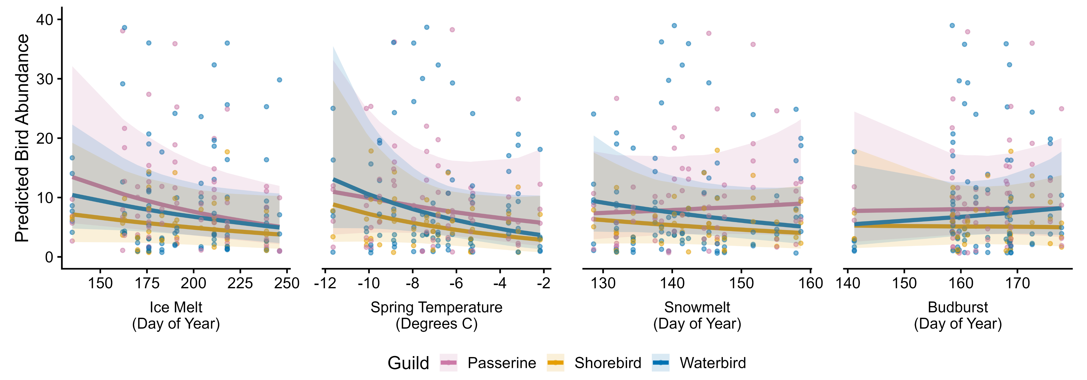
Figure X4: SEM
SEM plot
Predictions for each graph

Slide 12

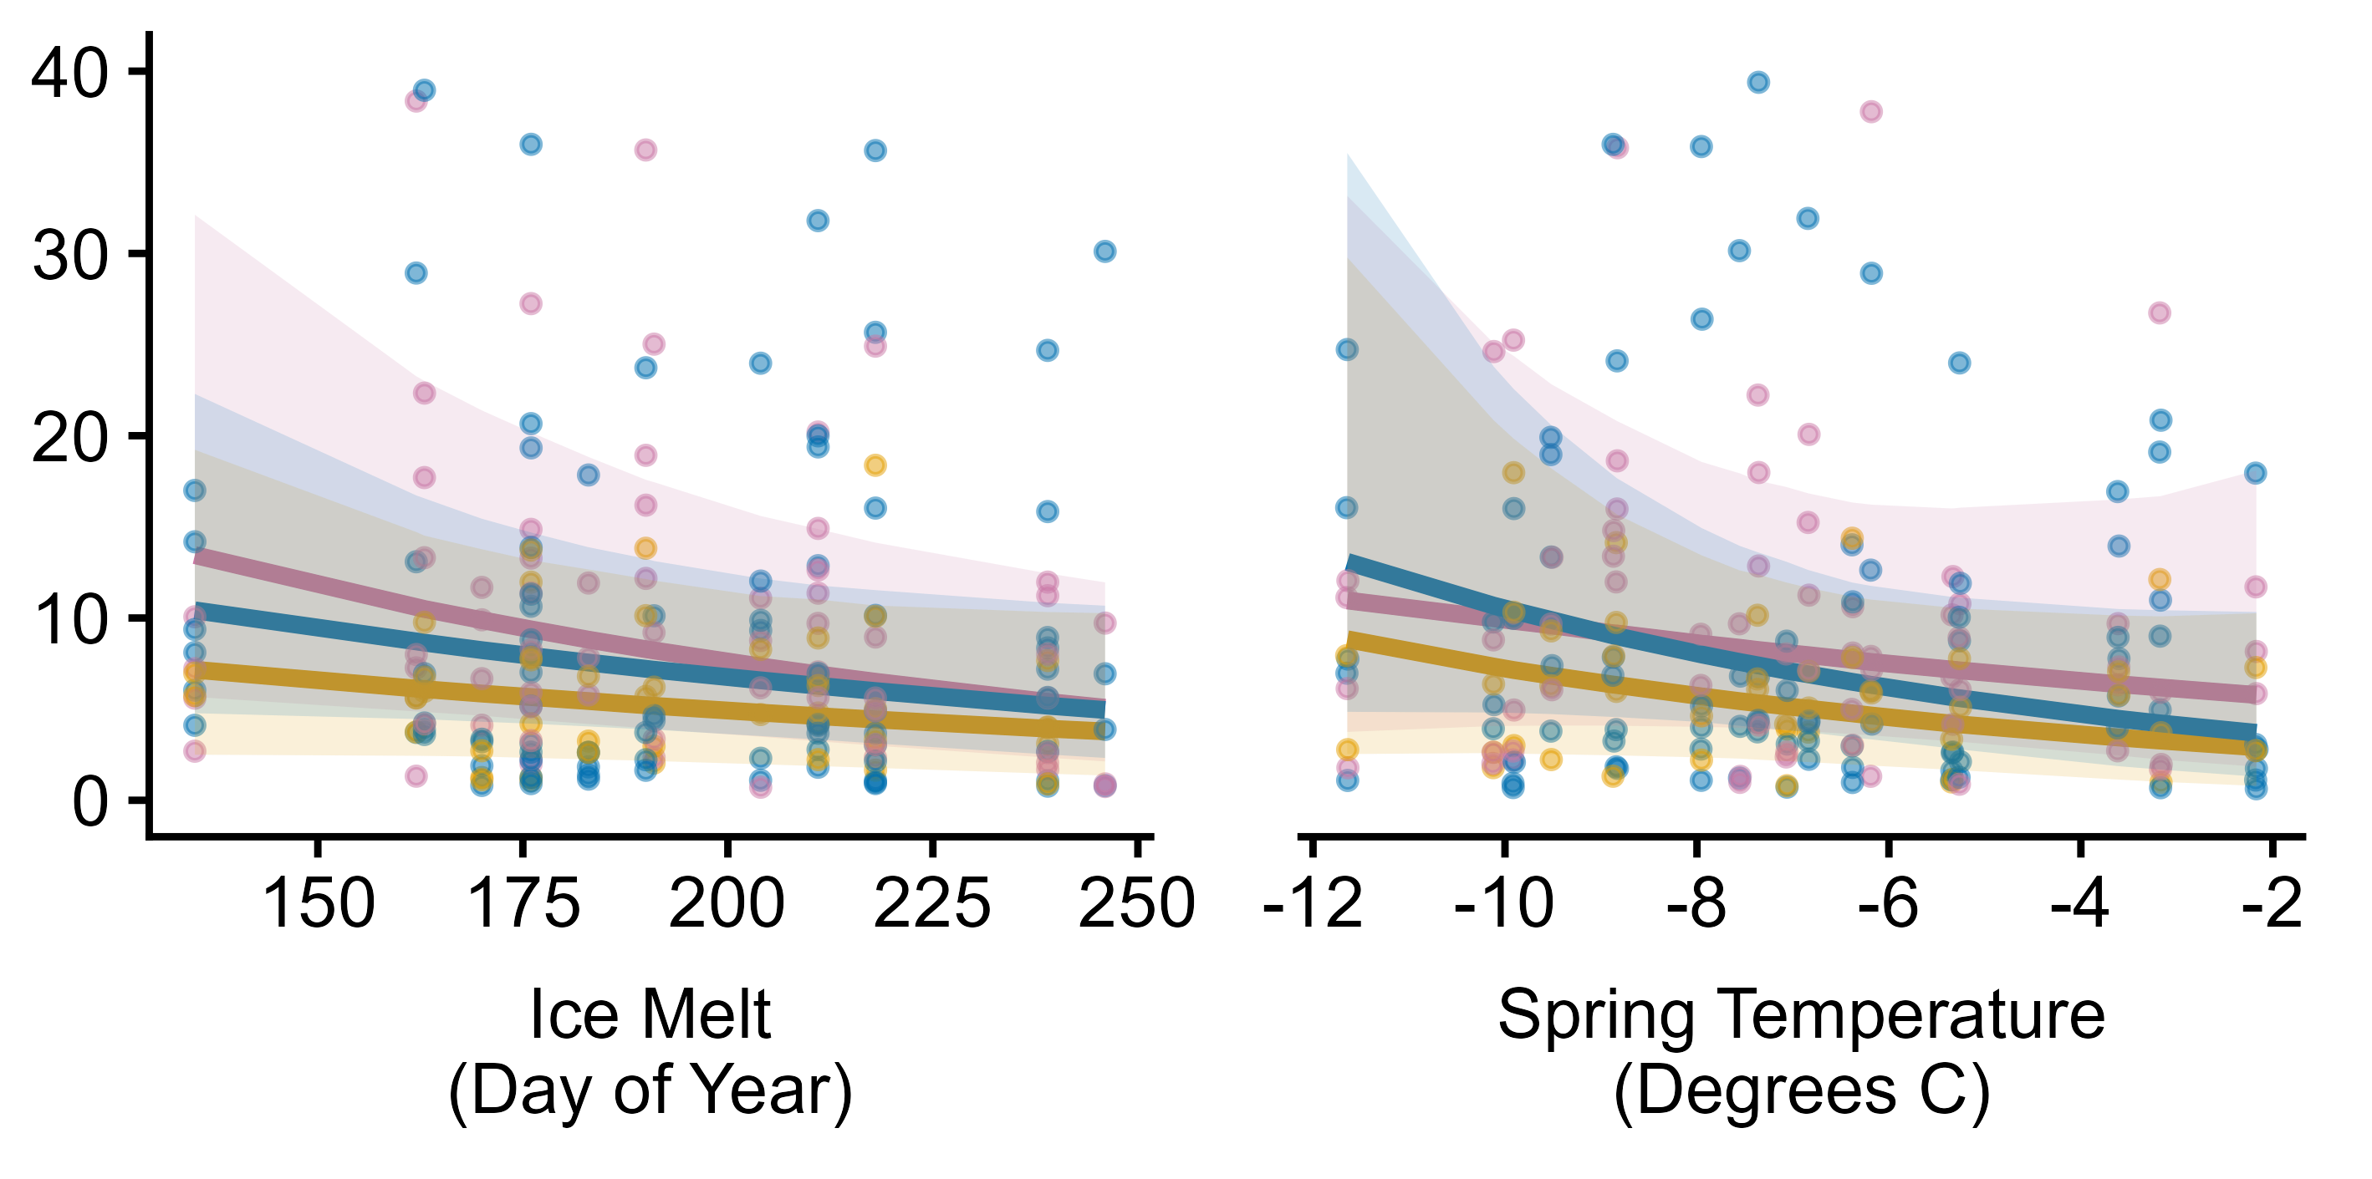
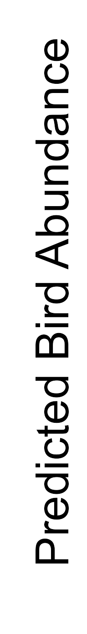
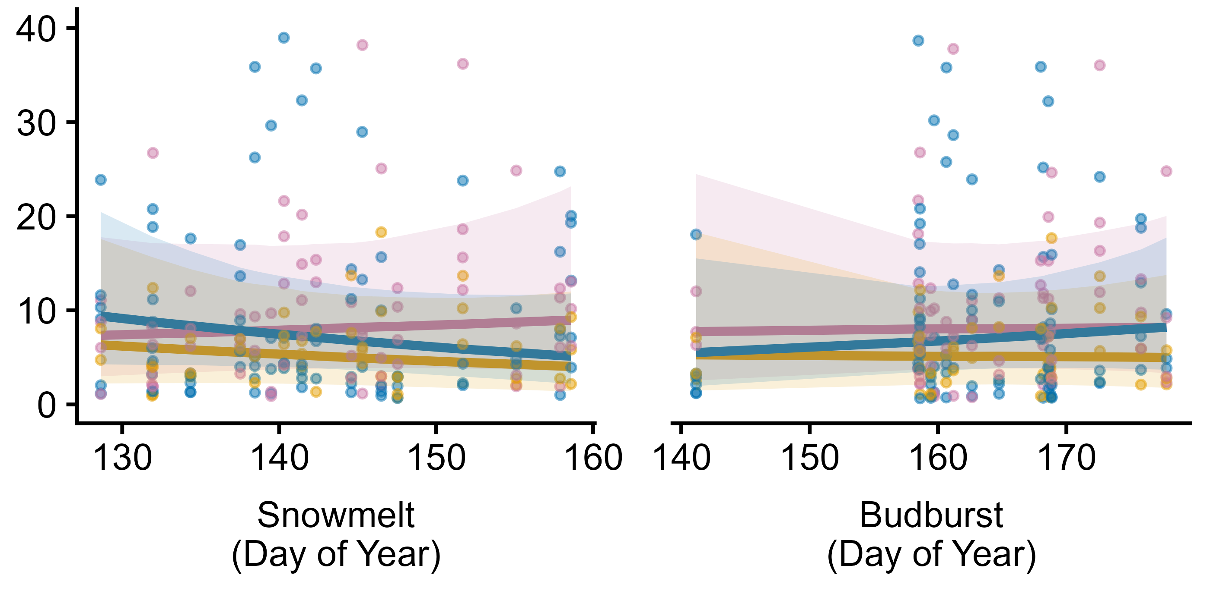
Figure X4: SEM
SEM plot
Predictions for each graph

Slide 13
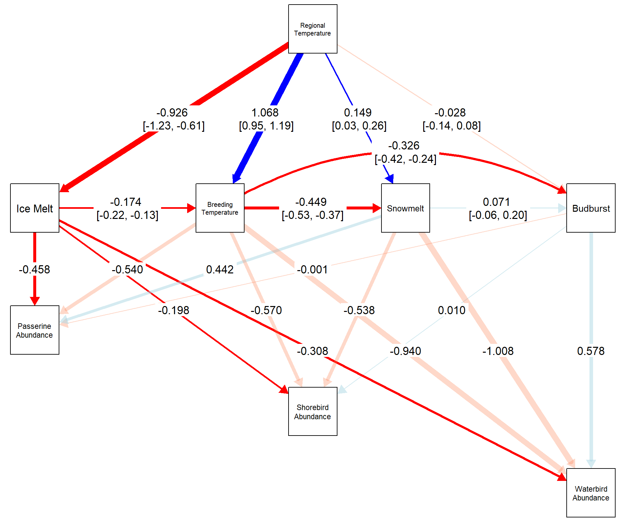
Figure X4: SEM
SEM plot
Predictions for each graph
"regional_temp" = "#999999", # Regional Temperature "breeding_temp" = "#ECDC06", # Breeding Temperature "icemelt" = "#56B4E9", # Icemelt "snowmelt" = "#D55E00", # Snowmelt "budburst" = "#009E73", # Budburst

Slide 14
Figure X2: Breeding Bird Survey and Variables Site Map
Map of North Slope (coastline length annotated)
Breeding Bird Survey Drawn Out (coastline length annotated)
Icemelt drop region polygon
Location of snowmelt and plant phenology transects
Komakuk breeding temperature site
Beaufort Sea, Mackenzie Delta
Sea Ice Drop Date
Komakuk Beach Breeding Temperature
Komakuk Beach Breeding Temperature
Phenology Transects
Budburst
Snowmelt

Slide 15
Figure X5: ARU vocalizations
Calling temp split plot
Regression
Colour coded picture of each bird

